Slide 1
Big Data Project
Quality Life Hub Using R Studio
April 21, 2026

Slide 2
Dataset Selection
Source: Statistics Canada – Quality of Life Hub
Topic: Good Governance- Confidence in Institutions
Variables: Confidence Level, Institutions, Gender, Age, Immigration Status, Area of Residence
Notes:
For this project, I selected a dataset from Statistics Canada about trust in others. I chose this topic because trust is an important social factor, and it allows me to compare differences across age groups and gender.

Slide 3
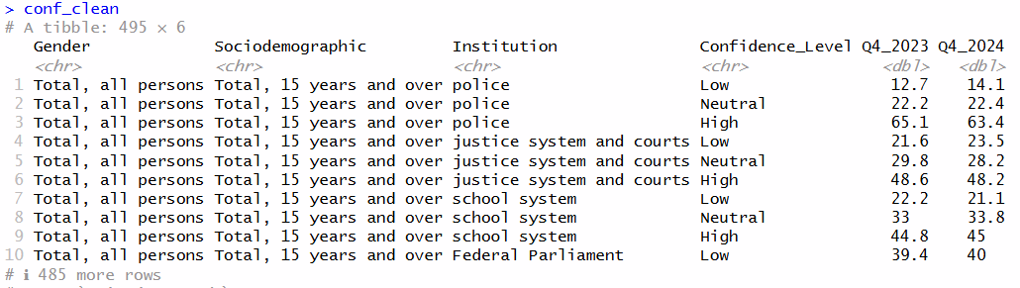


Confidence in Institutions
Data Transformation
Cleaned Table
Basic Data Cleaning in Stats Canada and .csv file
2. Additional Data cleaning check in R: missing, duplicate, reorder
3. Converting Confidence Levels 1-5 to oridnal “High”, “Neutral”, “Low”
4. Segregate variable ‘Indicators’ to ‘Confidence_Level’ and ‘Institutions’

Slide 4
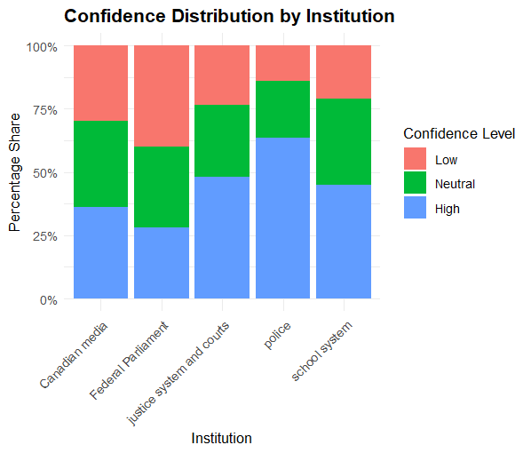



Confidence Distribution by Institutions
Insights:
Highest confidence- Police
Lowest confidence- Federal Parliament
Neutral confidence - high across all institutions

Slide 5
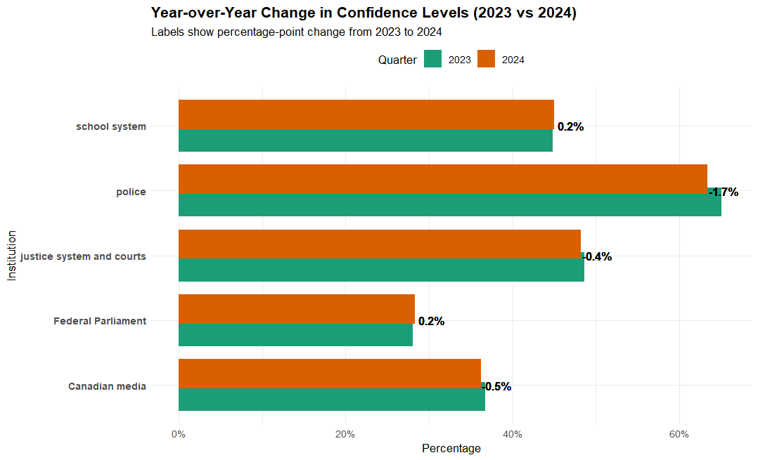

YoY Change in Confidence Levels
Insights:
Year‑over‑year confidence levels show minimal change
+0.5%
-1.7%
Canadian Media
Police

Slide 6
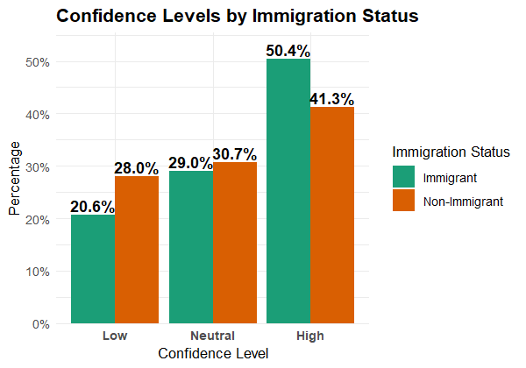
Confidence Levels by Immigration Status
Insights:
Immigrants are comparatively more confident.
More than half of Non-Immigrants are either unsure or have low confidence.

Slide 7
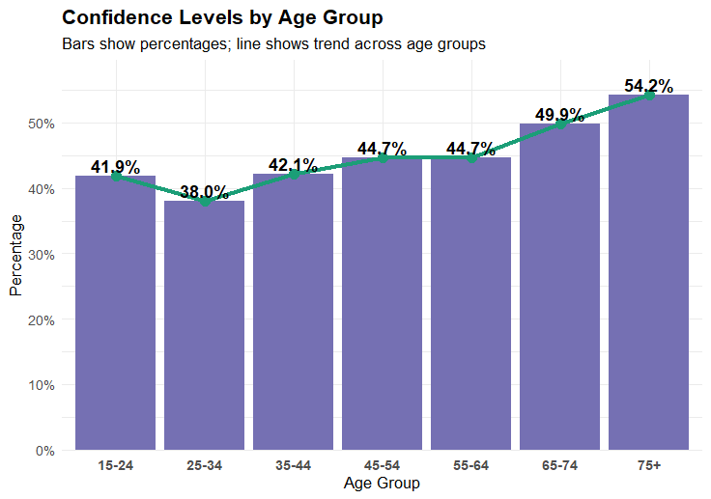


Confidence Levels by Age
Insights:
Upward sloping increasing trend
Younger respondents = lower confidence
Older respondents = higher confidence

Slide 8
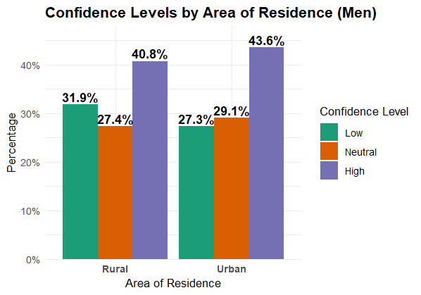
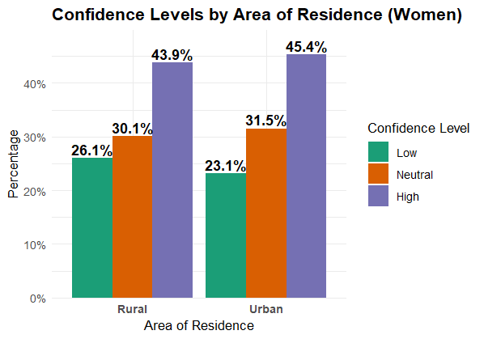



Confidence Levels by Area & Gender
Insights:
Both Rural population and Men have lower confidence.
Urban and Rural Women have higher Neutral scores

Slide 9
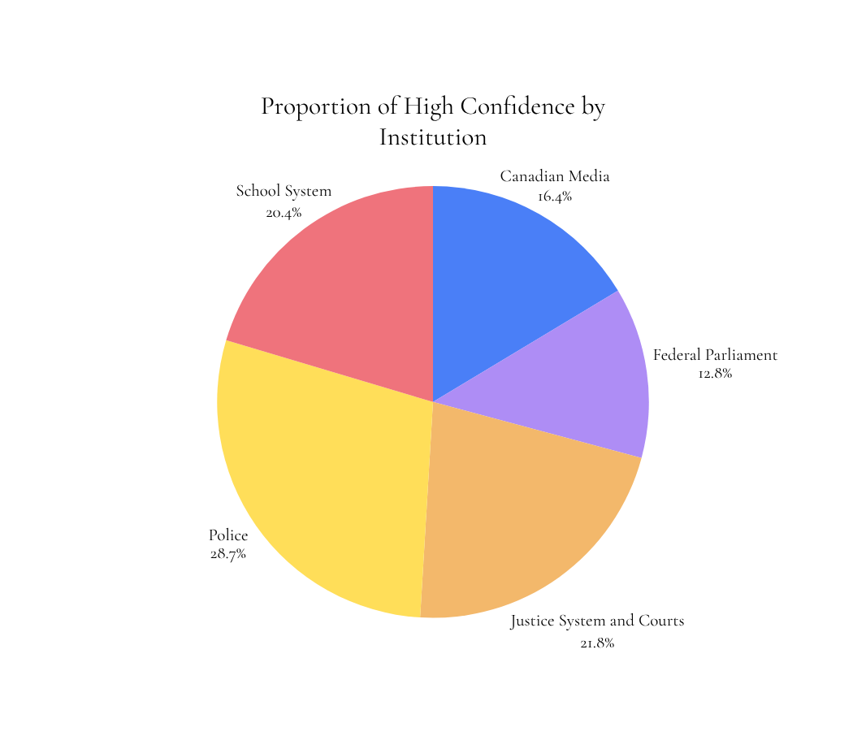

Summary
29.6%
Highest Low Confidence | Gender (Men)
54.2%
Highest Confidence | Age (75+)
50.4%
Highest Confidence | Immigrantion Status (Immigrants)
Conclusion: Confidence is highest in Police among immigrants, older urban residents, and women, largely reflecting differences in living experience, service accessibility and institutional trust.

Slide 10
References
Statistics Canada(Oct. 29, 2025). Confidence in institutions
https://www.statcan.gc.ca/hub-carrefour/quality-life-qualite-vie/good-governance-saine-gouvernance/institutions-eng.html
Statistics Canada(n.d.). Confidence in institutions, by gender and other selected sociodemographic characteristics
https://www150.statcan.gc.ca/t1/tbl1/en/tv.action?pid=4510007401
Notes:
For this project, I selected a dataset from Statistics Canada about trust in others. I chose this topic because trust is an important social factor, and it allows me to compare differences across age groups and gender.

Slide 11
#Loading the required packages
library(readr)
library(dplyr)
library(tidyr)
library(tidyverse)
library(ggplot2)
#---------------------------------------------------------------
#Loading the csv file
GG <- read_csv("Good Governance-Confidence in Institutions.csv")
GG
#--------------------------------------------------------------
#Data Cleaning
#Splitting the column "indicators" to "institution" and "confidence_level" to segregate them
conf <- GG %>%
mutate(
Institution = str_extract(Indicators,
"Confidence in the .*? rating"),
Institution = str_replace(Institution,
"Confidence in the ", ""),
Institution = str_replace(Institution,
" rating", ""),
Confidence_Level = case_when(
str_detect(Indicators, "1 or 2") ~ "Low",
str_detect(Indicators, "3") ~ "Neutral",
str_detect(Indicators, "4 or 5") ~ "High"
)
) %>%
select(-Indicators)
#Fill all the blanks for Gender and Sociodemographics
conf <- conf %>%
fill(Gender, .direction = "down") %>%
fill(Sociodemographic, .direction = "down")
eorder of the variables
conf_clean <- conf %>%
select(Gender, Sociodemographic, Institution, Confidence_Level,
Q4_2023, Q4_2024)
#Inspect the cleaned tibble
conf_clean
#----------------------------------------------------------------xxx------------------------------
#Confidence in Institutions
analysis1_data <- conf_clean %>%
filter(str_detect(Gender, "Total"),
str_detect(Sociodemographic, "Total")) %>%
select(Institution, Confidence_Level, Q4_2024) %>%
mutate(Confidence_Level = factor(Confidence_Level,
levels = c("Low", "Neutral", "High")))
ggplot(analysis1_data,
aes(x = Institution,
y = Q4_2024,
fill = Confidence_Level)) +
geom_col(position = "fill") +
scale_y_continuous(labels = scales::percent) +
labs(
title = "Confidence Distribution by Institution",
x = "Institution",
y = "Percentage Share",
fill = "Confidence Level"
) +
theme_minimal() +
theme(
axis.text.x = element_text(angle = 45, hjust = 1),
plot.title = element_text(face = "bold")
)
#--------------------------------------------------------------
#Year-over-Year Change in Confidence
analysis2_data <- conf_clean %>%
filter(
Confidence_Level == "High",
str_detect(Gender, "Total"),
str_detect(Sociodemographic, "Total")
) %>%
select(Institution, Q4_2023, Q4_2024) %>%
mutate(
Q4_2023 = Q4_2023 / 100,
Q4_2024 = Q4_2024 / 100,
Change = Q4_2024 - Q4_2023
) %>%
pivot_longer(
cols = c(Q4_2023, Q4_2024),
names_to = "Quarter",
values_to = "Value"
) %>%
mutate(
Quarter = recode(Quarter,
"Q4_2023" = "2023",
"Q4_2024" = "2024"),
Quarter = factor(Quarter, levels = c("2023", "2024"))
)
ggplot(analysis2_data,
aes(x = Institution,
y = Value,
fill = Quarter)) +
geom_col(position = position_dodge(width = 0.7)) +
geom_text(
data = analysis2_data %>% filter(Quarter == "2024"),
aes(label = scales::percent(Change, accuracy = 0.1),
y = Value + 0.02),
position = position_dodge(width = 0.7),
size = 3.5,
fontface = "bold"
) +
coord_flip() +
scale_y_continuous(labels = scales::percent) +
scale_fill_manual(values = c(
"2023" = "#1B9E77",
"2024" = "#D95F02"
)) +
labs(
title = "Year-over-Year Change in Confidence Levels (2023 vs 2024)",
subtitle = "Labels show percentage-point change from 2023 to 2024",
x = "Institution",
y = "Percentage",
fill = "Quarter"
) +
theme_minimal() +
theme(
plot.title = element_text(face = "bold"),
plot.subtitle = element_text(),
axis.text.y = element_text(face = "bold"),
legend.position = "top"
)
#----------------------------------------------------------------
# Confidence across Age
analysis3_age <- conf_clean %>%
filter(
Confidence_Level == "High",
str_detect(Gender, "Total"),
str_detect(Sociodemographic, "\\d"),
!str_detect(Sociodemographic, "Total")
) %>%
mutate(
Age_Group = Sociodemographic,
Q4_2024 = Q4_2024 / 100
) %>%
group_by(Age_Group) %>%
summarise(
High_Conf = mean(Q4_2024, na.rm = TRUE)
) %>%
ungroup()
analysis3_age <- analysis3_age %>%
mutate(
Age_Group = case_when(
Age_Group == "15 to 24 years" ~ "15-24",
Age_Group == "25 to 34 years" ~ "25-34",
Age_Group == "35 to 44 years" ~ "35-44",
Age_Group == "45 to 54 years" ~ "45-54",
Age_Group == "55 to 64 years" ~ "55-64",
Age_Group == "65 to 74 years" ~ "65-74",
Age_Group == "75 years and over" ~ "75+",
TRUE ~ Age_Group
)
)
Confidence in Institutions

Slide 12
ggplot(analysis3_age,
aes(x = Age_Group,
y = High_Conf,
group = 1)) +
geom_col(fill = "#7570B3") +
# Trend line connecting bar tops
geom_line(color = "#1B9E77", size = 1.2) +
geom_point(color = "#1B9E77", size = 3) +
# Labels on top of bars
geom_text(
aes(label = scales::percent(High_Conf, accuracy = 0.1)),
vjust = -0.3,
size = 4,
fontface = "bold"
) +
scale_y_continuous(
labels = scales::percent,
expand = expansion(mult = c(0, 0.1))
) +
labs(
title = "Confidence Levels by Age Group",
subtitle = "Bars show percentages; line shows trend across age groups",
x = "Age Group",
y = "Percentage"
) +
theme_minimal() +
theme(
plot.title = element_text(face = "bold"),
axis.text.x = element_text(face = "bold", vjust = 0.5)
)
#----------------------------------------------------------------
# Confidence Level between the Immigration groups
analysis_imm <- conf_clean %>%
filter(
str_detect(Gender, "Total"),
Confidence_Level %in% c("Low", "Neutral", "High"),
str_detect(Sociodemographic, "Immigr") | str_detect(Sociodemographic, "Non")
) %>%
mutate(
Immigration_Status = case_when(
str_detect(Sociodemographic, "Non") ~ "Non-Immigrant",
str_detect(Sociodemographic, "Immigr") ~ "Immigrant"
),
Q4_2024 = Q4_2024 / 100
) %>%
group_by(Immigration_Status, Confidence_Level) %>%
summarise(
Value = mean(Q4_2024, na.rm = TRUE)
) %>%
ungroup()
analysis_imm$Confidence_Level <- factor(
analysis_imm$Confidence_Level,
levels = c("Low", "Neutral", "High")
)
ggplot(analysis_imm,
aes(x = Confidence_Level,
y = Value,
fill = Immigration_Status)) +
geom_col(position = position_dodge(width = 0.9)) +
geom_text(
aes(label = scales::percent(Value, accuracy = 0.1)),
position = position_dodge(width = 0.9),
vjust = -0.3,
size = 4,
fontface = "bold"
) +
scale_y_continuous(
labels = scales::percent,
expand = expansion(mult = c(0, 0.1))
) +
scale_fill_manual(values = c(
"Immigrant" = "#1B9E77",
"Non-Immigrant" = "#D95F02"
)) +
labs(
title = "Confidence Levels by Immigration Status",
x = "Confidence Level",
y = "Percentage",
fill = "Immigration Status"
) +
theme_minimal() +
theme(
plot.title = element_text(face = "bold"),
axis.text.x = element_text(face = "bold")
)
#----------------------------------------------------------------
#Confidence by Age and Area of Residence
analysis_gender_area <- conf_clean %>%
filter(
Confidence_Level %in% c("Low", "Neutral", "High"),
str_detect(Gender, "Men|Women"),
str_detect(Sociodemographic, "Urban|Rural")
) %>%
mutate(
Gender = ifelse(str_detect(Gender, "Men"), "Men", "Women"),
Area = ifelse(str_detect(Sociodemographic, "Urban"), "Urban", "Rural"),
Q4_2024 = Q4_2024 / 100
) %>%
group_by(Gender, Area, Confidence_Level) %>%
summarise(
Value = mean(Q4_2024, na.rm = TRUE)
) %>%
ungroup()
analysis_gender_area$Confidence_Level <- factor(
analysis_gender_area$Confidence_Level,
levels = c("Low", "Neutral", "High")
)
plot_gender_area <- function(gender_name) {
df <- analysis_gender_area %>% filter(Gender == gender_name)
ggplot(df,
aes(x = Area,
y = Value,
fill = Confidence_Level)) +
geom_col(position = position_dodge(width = 0.9)) +
geom_text(
aes(label = scales::percent(Value, accuracy = 0.1)),
position = position_dodge(width = 0.9),
vjust = -0.3,
size = 4,
fontface = "bold"
) +
scale_y_continuous(
labels = scales::percent,
expand = expansion(mult = c(0, 0.1))
) +
scale_fill_manual(values = c(
"Low" = "#1B9E77",
"Neutral" = "#D95F02",
"High" = "#7570B3"
)) +
labs(
title = paste("Confidence Levels by Area of Residence (", gender_name, ")"
, sep = ""),
x = "Area of Residence",
y = "Percentage",
fill = "Confidence Level"
) +
theme_minimal() +
theme(
plot.title = element_text(face = "bold"),
axis.text.x = element_text(face = "bold")
)
}
plot_gender_area("Men")
plot_gender_area("Women")
#----------------------------------------------------------------
#Calculate proportions for Pie-chart
institution_proportions <- conf_clean %>%
filter(
Confidence_Level == "High",
str_detect(Gender, "Total"),
str_detect(Sociodemographic, "Total")
) %>%
mutate(
Q4_2024 = Q4_2024 / 100
) %>%
group_by(Institution) %>%
summarise(
High_Conf = mean(Q4_2024, na.rm = TRUE)
) %>%
ungroup() %>%
mutate(
Proportion = High_Conf / sum(High_Conf)
)
institution_proportions

